Slide 1
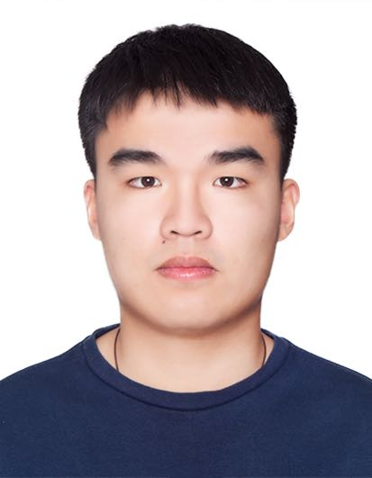


AI Path Planning:
Introducing a new algorithm based on the VNS approach for the artificial potential field method to avoid local minima
Tutor: Zibo Wang
Members: Yixi Rao
Chun Wu
Yifan Li
Yixi Rao
Chun Wu
Yifan Li
Notes:
Hi, everyone attending today’s 15mins presentation.
I am Chun Wu. Our project is under big theme of AI Planning.
And our project is about introducing a new algorithm ….
Thanks tutor zibo, team members…

Slide 2
Outline
Section 1: Introduction and background
What is APF algorithm
Problem
Signposting
Section 2: literature analysis
Current State of Art of APF
Literature in-depth study
Section 3: New approach and Conclusion
VNS algorithm
Motivation
Definition
Conclusion
Section 4: Extension and Future work
Limitation of VNS + APF
Future work
Notes:
In this presentation we would present this project in 4 sections,
I would be brieflyintroducing the background of Artificial potential field algorithm, and then do some literature analysis. And yixi would comprehensively introducing our algorithm. Then would talk about extension and future improvements.

Slide 3
Section 1: introduction and background
What is APF
Problems
Context
Signposting
Notes:
In section 1, lets starts with some basic knowledge of what is APF..

Slide 4
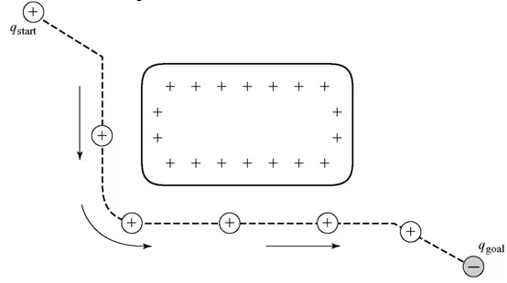
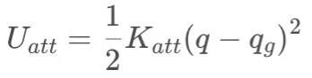
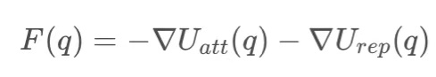
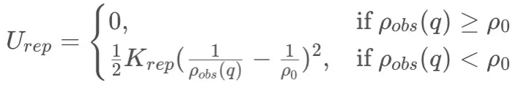
What is APF?
Artificial Potential field method is a virtual force method for motion planning.
The potential energy is low at the goal and high at the obstacles producing attraction and repulsion respectively.
Attractive potential:
Resultant force:
Repulsive potential:
Notes:
THE full name of APF is artificial potential field method, it is a virtual force method for motion planning. The basic work principle for this algorithm is for that in the pre-constructed potential field, the potential energy is low at the goal and high at the obstacles thus producing attraction and repulsion driving the particle which is the robot to move around obstacles and reach the goal. The whole process is shown in the right hand, and the forces and defined as below.

Slide 5
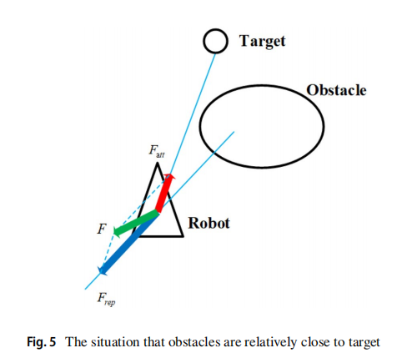
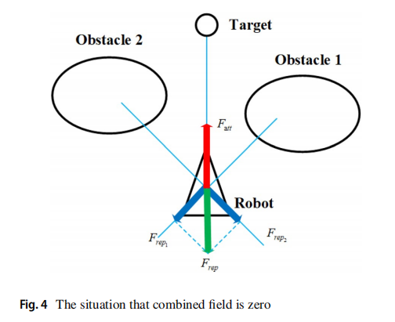
Problems
Traditional APF method has problems:
Goal non-reachable with obstacles nearby problem (local minima encountered!)
“First would be Goal non-reachable with obstacles nearby problem, it Is the main problem of the traditional artificial potential field model. It means that the robot would fall into the local minimum point of the potential field in advance before reaching the target point and is Unable to reach the target.” [1]
(2) Goal non-reachable with resultant force = 0
“Where the combined field is zero, F_{att} and F_{rep} cancel out each other, which makes it difficult for APFM to judge trajectory, or even causes the local optimal solution problems” [3]
(1)
(2)
[1]: DF Zhang, F Liu - Computer Engineering & Science, 2013 Research and development trend of path planning based on artificial potential field method [J]
[2] Fig.5: Li, H., Gong, D. & Yu, J. An obstacles avoidance method for serial manipulator based on reinforcement learning and Artificial Potential Field. Int J Intell Robot Appl (2021). https://doi.org/10.1007/s41315-021-00172-5
[3]: Li, H., Gong, D. & Yu, J. An obstacles avoidance method for serial manipulator based on reinforcement learning and Artificial Potential Field. Int J Intell Robot Appl (2021). https://doi.org/10.1007/s41315-021-00172-5
Notes:
However, this algorithm could have some serious problems. That’s our motivation of the project. The traditional APF method has problems as the Goal non reachable problems. This could happen when local minima encountered or when the resultant force is qual to 0.

Slide 6
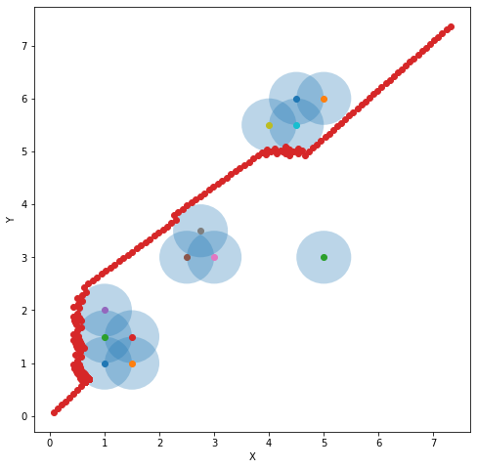
Context
Obstacles of different shapes such as polygons can be approximately represented as a combination of point obstacles.
In our research, we use point obstacles with their corresponding influence region to represent the real obstacles.
Notes:
And to solve this problem, we would introducing our definition of the obstacles in order to process the improvements. ……………..

Slide 7
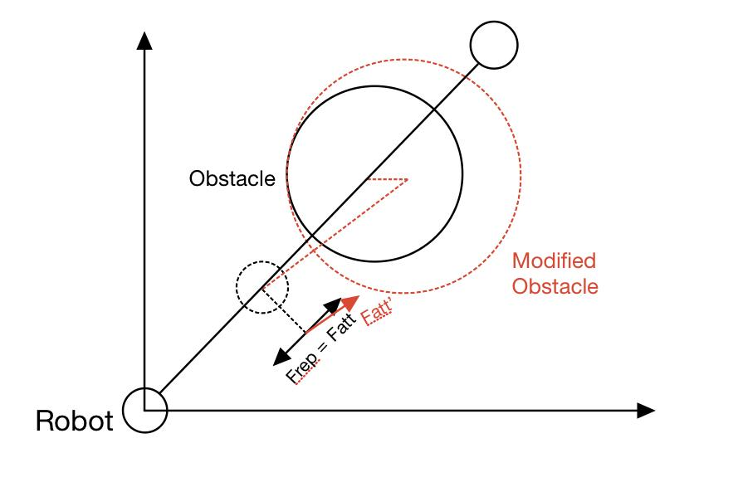
Signposting
Solve Goal non-reachable with resultant force = 0
When the center of the obstacle is collinear with the robot, the resultant force is zero.
Intuitive solution:
Change the center of the obstacle a little to avoid collinearity.
Notes:
Furthermore, we first did some small fix for the first problem solution, that is to solve goal non reachable when the resultant foce = 0, after analysis of the situation, the cause is to be when the center of the obstavles is collinear with the robot and then is force would be zero. Therefore, we think of an intuitive solution, that si to change the center of the obstacle a little to avoid collineartly

Slide 8
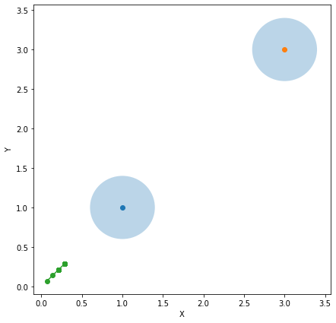
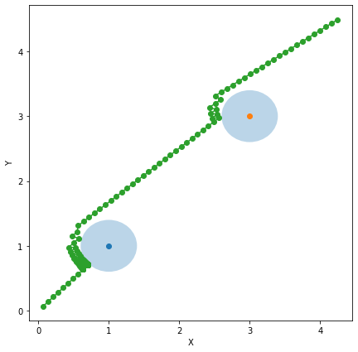
Signposting
Solve Goal non-reachable with resultant force = 0
Original APF
Modified APF
Notes:
In this two pcitures, that is shown that the modified apf could generate a successful path.

Slide 9
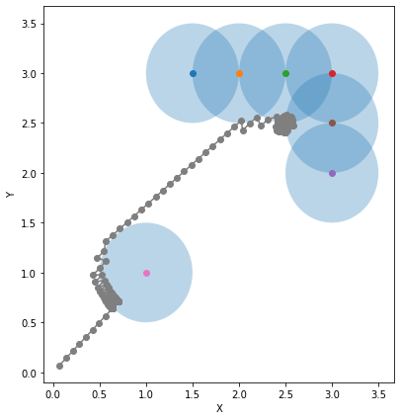
Signposting
Solve Goal non-reachable with local minima encountered
When the obstacles are gathered but with gaps inside, the robot will fall into local minima.
Intuitive solution:
Fill the obstacle to make a complete polygon.
Notes:
And our signposting method could also solve the local minima problem by filling the obstacle to make a complete polyhgon

Slide 10
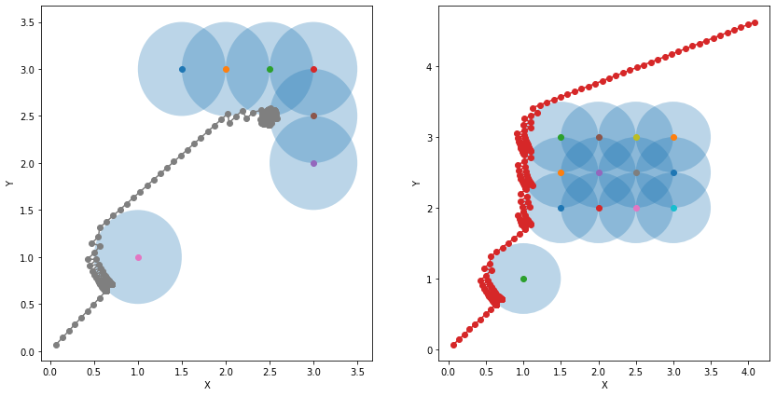
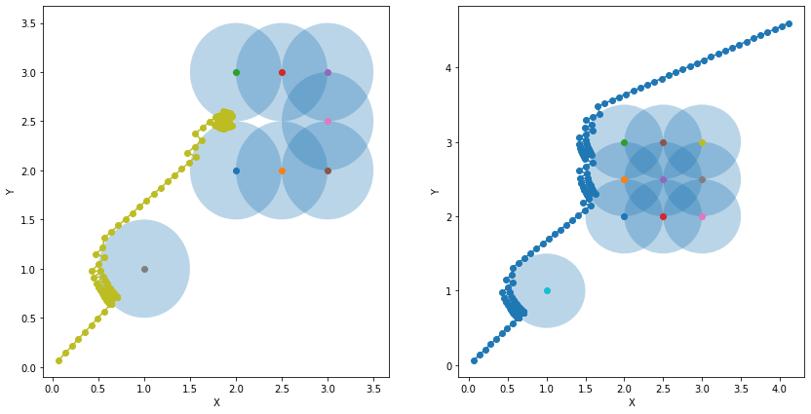
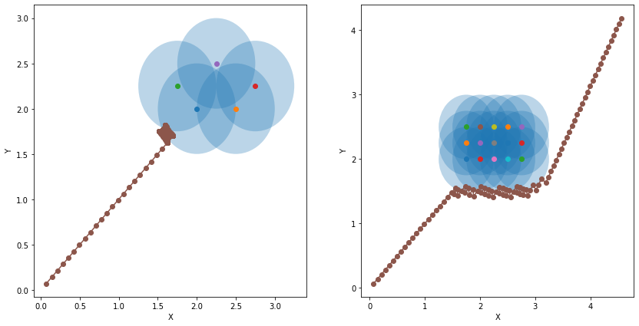
Signposting
Solve Goal non-reachable with local minima encountered
Notes:
Here are some test examples for the algortithm successfully generated the path

Slide 11
Reflection
The change in the center of obstacles -- Solve resultant force = 0
The filling of the irregular obstacles -- Solve local minima
The increase of obstacle influence region
The path obtained not optimal
A more robust, complete and optimal algorithm should be introduced to fully tackle the problem of traditional Artificial Potential Field Method.
Notes:
However though this first improvement had some effects, bnut its still not optimal, thus a …..would be introduced..

Slide 12
Abstract / key message
Our new approach based on the BVNS (basic variable neighbourhood search) can:
Achieve local minima avoidance
It is possible to produce a suboptimal solution
Can adapt many different circumstances by adding some new neighbourhoods or changing the order of already existed neighbourhoods
Notes:
This new approach is…

Slide 13
Section 2: literature analysis
State of the art
LMR
LME
LMA
RL-APF

Slide 14
Current State of Art of APF
In order to solve the problem of GNRON in the traditional artificial potential field model, early research mainly improved the traditional method from three aspects.
Local minima removal: modify the APF function
Laplace's equation
Gaussian function
…
Local minima escape: escape algorithm
simulated annealing
genetic algorithm
…
Local minima avoidance: Need some initial knowledge of environment
deterministic annealing
…
Or combine the artificial potential field algorithm with other methods:
RL
RL-APFM

Slide 15
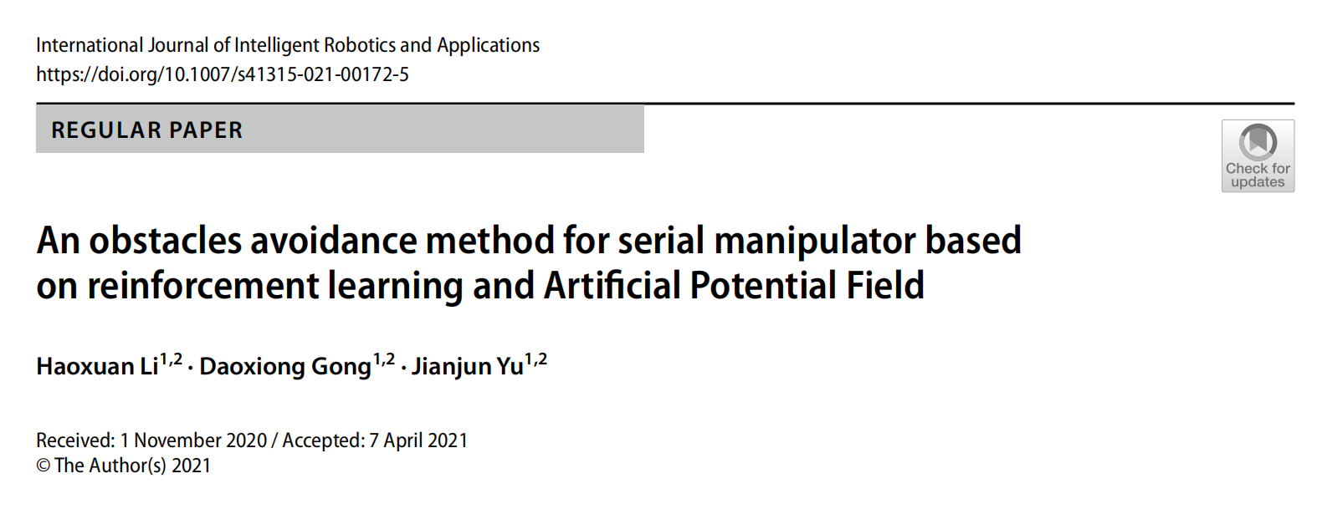
Literature in-depth study
Reference: Li, H., Gong, D. & Yu, J. An obstacles avoidance method for serial manipulator based on reinforcement learning and Artificial Potential Field. Int J Intell Robot Appl (2021). https://doi.org/10.1007/s41315-021-00172-5

Slide 16
Literature Summary
Artificial Potential Field Method (APFM) + Reinforcement Learning (RL)
RL-APFM (offline algorithm)
Two factors (make RL and APFM integrated more effectively) :
Distance Reinforcement Factors (DRF)
activated when the robot enters the influence region of the obstacles to keep the robot away from them
Force Reinforcement Factors (FRF)
activated when the robot collides with obstacles to let the robot escape from them
Reference: Li, H., Gong, D. & Yu, J. An obstacles avoidance method for serial manipulator based on reinforcement learning and Artificial Potential Field. Int J Intell Robot Appl (2021). https://doi.org/10.1007/s41315-021-00172-5

Slide 17
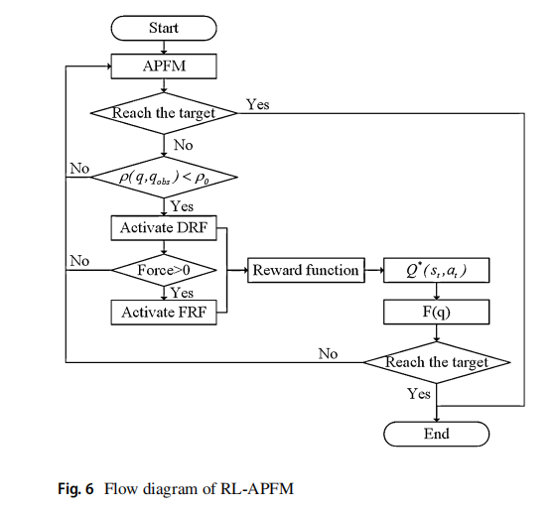
Literature Summary (cont.)
Distance Reinforcement Factors (DRF)
determined by the distance between the robot and the obstacles
Force Reinforcement Factors (FRF)
determined by the collision force between the robot and the obstacles
Reference: Li, H., Gong, D. & Yu, J. An obstacles avoidance method for serial manipulator based on reinforcement learning and Artificial Potential Field. Int J Intell Robot Appl (2021). https://doi.org/10.1007/s41315-021-00172-5

Slide 18
Literature Summary (cont.)
Verification of RL-APFM:
Simulation
RL-APFM reach target closing to obstacles without falling into local minima.
RL-APFM avoids dynamic obstacles without collision.
RL-APFM avoids obstacles with shorter time and fast iteration.
Physical experiments
RL-APFM avoids obstacles with and without collision in a static and dynamic environment.
RL-APFM shows better performance when the target is closed to the obstacles.
Reference: Li, H., Gong, D. & Yu, J. An obstacles avoidance method for serial manipulator based on reinforcement learning and Artificial Potential Field. Int J Intell Robot Appl (2021). https://doi.org/10.1007/s41315-021-00172-5

Slide 19
Literature Summary (cont.)
Conclusion:
RL-APFM avoids dynamic obstacles, eliminates local minima, and arrives at the target closed to the obstacles.
RL-APFM can be successfully implemented into a real robot to perform obstacles avoidance.
Reference: Li, H., Gong, D. & Yu, J. An obstacles avoidance method for serial manipulator based on reinforcement learning and Artificial Potential Field. Int J Intell Robot Appl (2021). https://doi.org/10.1007/s41315-021-00172-5

Slide 20
Section 3: New approach
VNS algorithm
Motivation
Definition
Solution
Neighbourhood
Evaluation
Conclusion
Limitation of VNS + APF
Future work
Notes:
Section 3 we are going to introduce the new approach

Slide 21
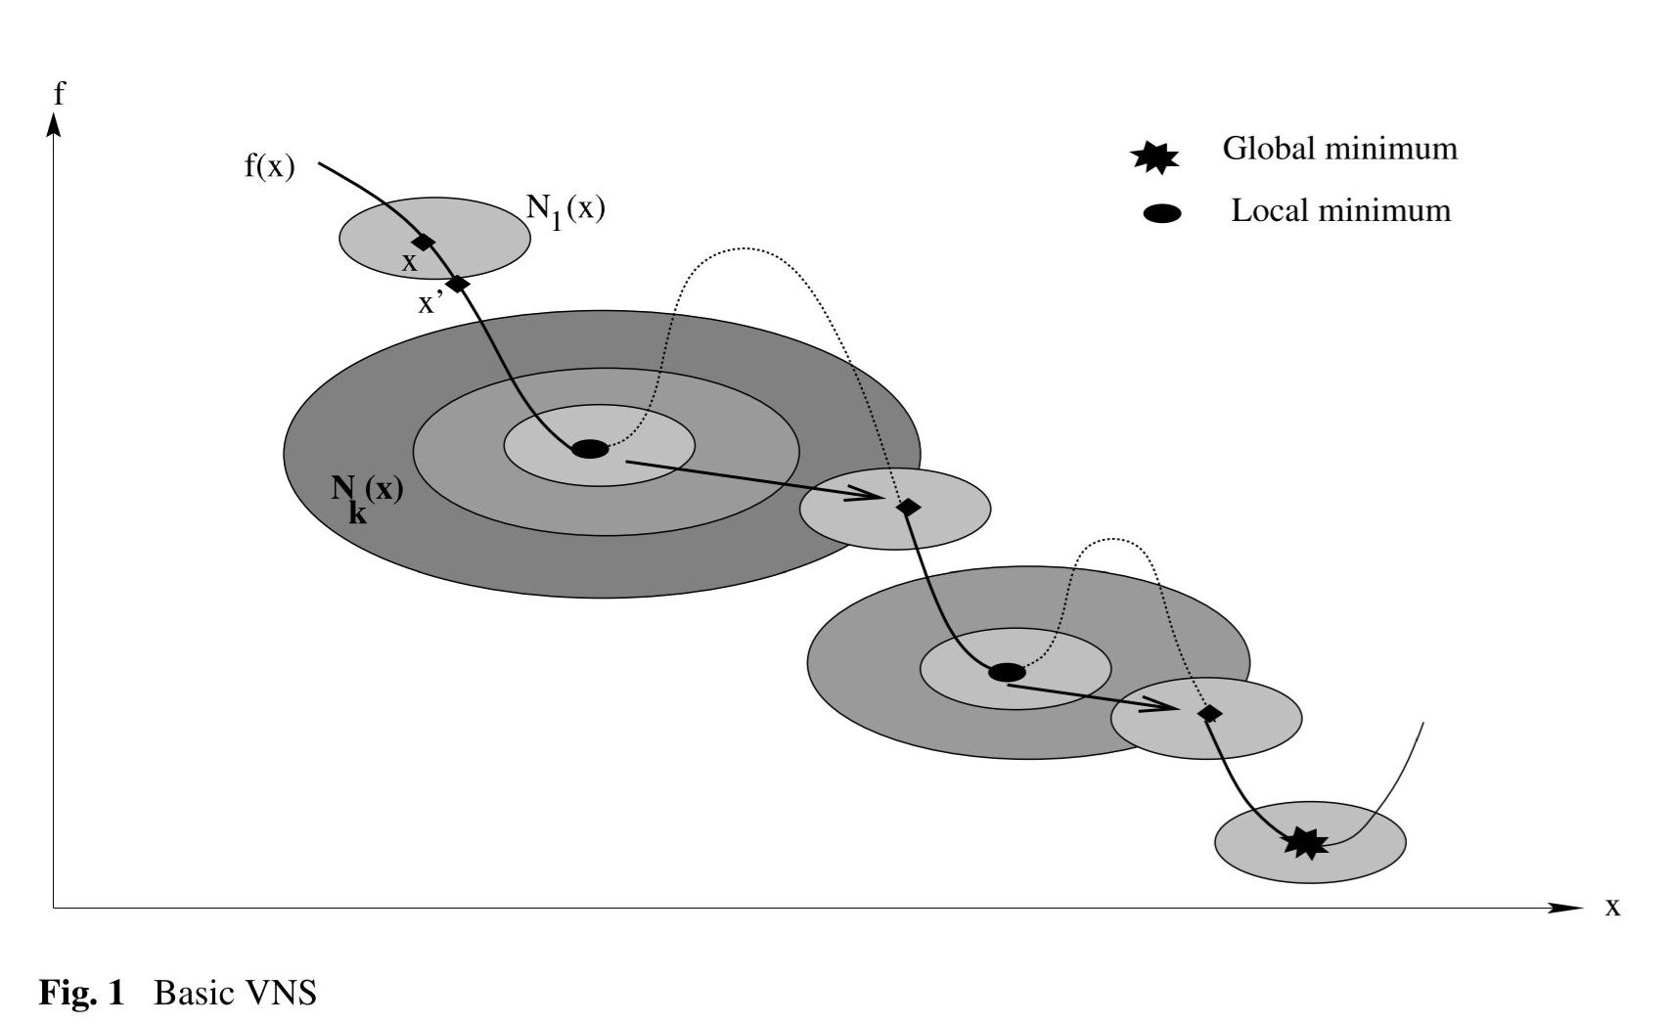
New approach based on Variable neighbourhood search (VNS)
The proposed approach builds on the Basic Variable Neighborhood Search (BVNS) metaheuristic^{[1]}
VNS algorithms work by repeatedly chaining^{[2]}
(i) a descent phase: providing local improvements to an existing solution through systematic change of neighborhood^{[2]};
(ii) a perturbation phase: aims at escaping the valley of the local optimum reached during the descent phase^{[2]}
Round 1
N1
go through all the three neighborhoods
Find improvement in N1
Round 2
N1
N2
N3
So perturb it
Round 3
N1
Round 4
N2
Local minimum
N1
Round 5
N1
Round 6
N1
Global minimum
[1] Hansen, P., Mladenović, N. & Moreno Pérez, J.A. Variable neighbourhood search: methods and applications. Ann Oper Res 175, 367–407 (2010). https://doi.org/10.1007/s10479-009-0657-6
[2] Bit-Monnot, A., Bailon-Ruiz, R., & Lacroix, S. (2018). A Local Search Approach to Observation Planning with Multiple UAVs. Proceedings of the International Conference on Automated Planning and Scheduling, 28(1). Retrieved from https://ojs.aaai.org/index.php/ICAPS/article/view/13924
Notes:
Our new approach builds on the Basic Variable Neighborhood Search (BVNS) metaheuristic, precisely we are using The Basic VNS method with the first improvement local search algorithm embedded in, and this new approach will find a solution which can avoid the current local minima optimally.
the VNS is a local search algorithm, It uses the neighborhood structure to search. it contains two phases,
the first phase is the descent phase which provides a local improvement to an existing solution, if it finds an improvement in one neighborhood, it will go back to the first neighborhood and start again. Like the picture on the right, x is a solution and it finds an improved solution in N1 neighbourhood, then it will return back N1 and start searching again.
After it go through all the neighborhoods and it cannot find any improvement, it will do a Shuffling by perturbing the current plan and create a new plan, this step is aiming at escaping the valley of the local optimum reached during the descent phase. For example in this figure, if it can find any improvement in round 2 in all three neighborhoods n1, n2, n3, so it will do a perturbation.
These two phases will be repeated until time out

Slide 22
Motivation
One of the key benefits of VNS is its very generic and adaptable definition. And each neighborhood proposes a local plan adaptation that improves a particular aspect of the solution^{[1]}.
LME is inefficient so the future research direction can be focused on how to implement the function of finding the optimal path.^{[2]}
If there are no obstacles, the robot will find an optimal path because of the gradient descent method
So, we decide to manipulate the paths that have been generated to solve the problem
No considerable effort has been made to apply the VNS technique to APF
[1] Bit-Monnot, A., Bailon-Ruiz, R., & Lacroix, S. (2018). A Local Search Approach to Observation Planning with Multiple UAVs. Proceedings of the International Conference on Automated Planning and Scheduling, 28(1). Retrieved from https://ojs.aaai.org/index.php/ICAPS/article/view/13924
[2] 16-23. GUO Yinjing, LIU Qi, BAO Jiankang, et al. Overview ofAUV obstacle avoidance algorithm based on artificial potential
field method. Computer Engineering and Applications, 2020, 56（4）:16-23
[3] Hansen, P., Mladenović, N. & Moreno Pérez, J.A. Variable neighbourhood search: methods and applications. Ann Oper Res 175, 367–407 (2010).
.
Notes:
One of the key benefits of VNS is its very generic and adaptable definition. And each neighborhood typically proposes a local plan adaptation that improves a particular aspect of the solution. (so for our project, for example, we can have a neighborhood to have some Local Path Optimizations. )
LME is inefficient because of the redundant waypoints generated in the escape phase, so the future research direction can be focused on finding an optimal solution or suboptimal solution of APF
And also there is an important fact about APF.
we found that if there are no obstacles, the robot will generate an optimal path because APF using the gradient descent method which will find the direction of the fastest gradient descent, So, we decide to manipulate the paths that have been generated to solve the problem
and also no considerable effort has been made to apply the VNS technique to APF

Slide 23
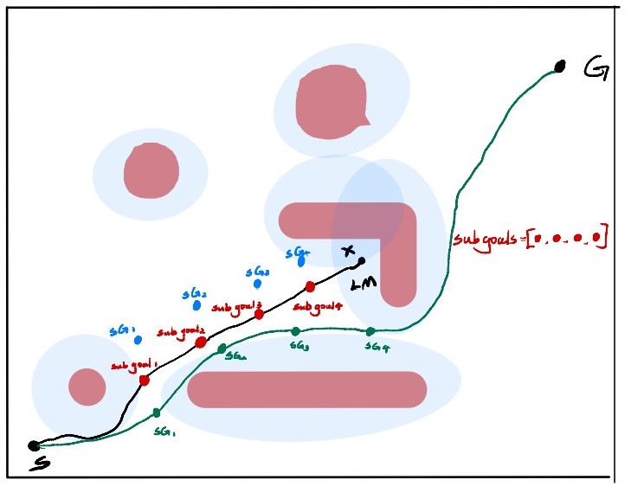
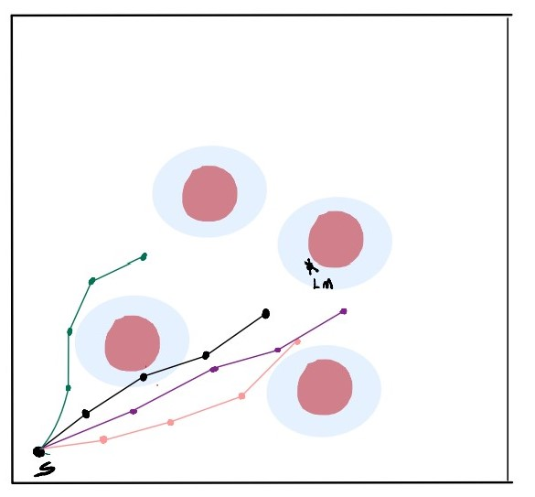
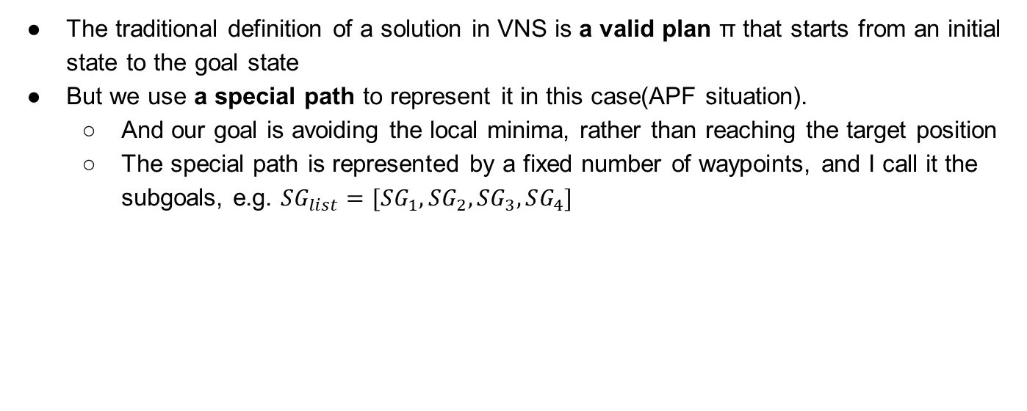
Definition: “Solution”
The traditional definition of a solution in VNS is a valid plan π that starts from an initial state to the goal state
But we use a special path to represent it in this case(APF situation).
And our goal is avoiding the local minima, rather than reaching the target position
The special path is represented by a fixed number of waypoints, and I call it the subgoals, e.g. $SG_{list}=[SG_{1},SG_{2}, SG_{3},SG_{4}]$
Notes:
The original definition of solution in VNS is a valid plan π that starts from an initial state to the goal state, the goal state might be the target location. But we use a special path to represent it in this case. our goal is no longer to reach the target position, but finding a path which can avoid the local minima.
The special path is represented by a fixed number of waypoints, and I call it the subgoals.
In this graph, the black path is the initial path that will be stuck at LM. all the red points are the subgoals which are extracted from the black path. The blue one is another solution and also the green one.
The reason why I call it the sub-goal is the agent must reach all the subgoals according to the order in the list before reaching the real goal
(fei qi)
So after it finds a decent subgoal list.
the attractive potential source will be changed to the first subgoal in the list, instead of the real goal,
then the agent will move to that first sub-goal.
when it reaches the first sub-goal, it will move to the next subgoal, and so on,
finally it will move to the real goal, and That's why I call it subgoal, the agent must reach all the subgoals first before reaching the real goal.

Slide 24
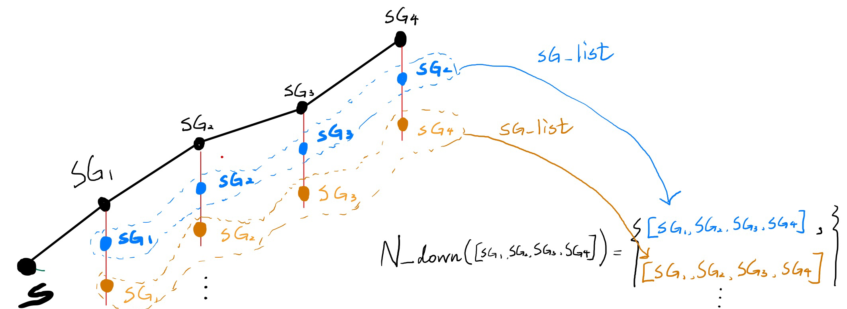
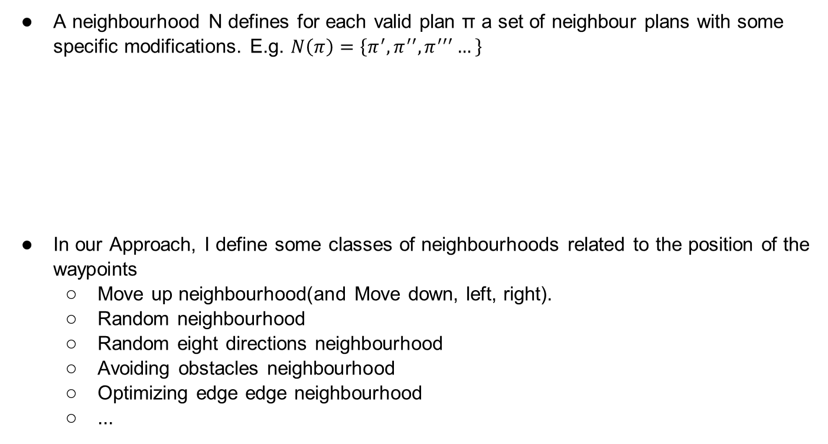
Definition: Neighbourhood
A neighbourhood N defines for each valid plan π a set of neighbour plans with some specific modifications. E.g. $N\left(π\right)=\left\{π^{′}, π^{′′},π^{′′′}…\right\}$
In our Approach, I define some classes of neighbourhoods related to the position of the waypoints
Move up neighbourhood(and Move down, left, right).
Random neighbourhood
Random eight directions neighbourhood
Avoiding obstacles neighbourhood
Optimizing edge edge neighbourhood
...
Notes:
A neighbourhood N defines for each valid plan a set of neighbour plans.
and this is an example of move down neighbourhood, the initial subgoal list is the black one, the blue subgoal list and the orange subgoal list is the black one's neighbour
In our Approach, I define some classes of neighbourhoods related to the shifting of the position of the subgoals,
we have the following neighbourhoods..
(feiqi)
1. Moving four direction neighbourhood 2. And some random neighbourhoods 3. some local path optimization neighbourhoods. and so on.

Slide 25
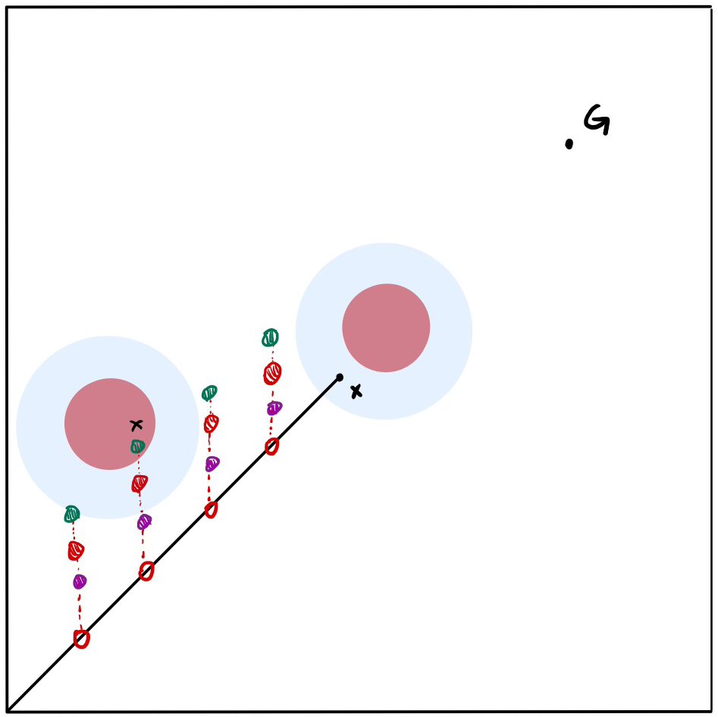
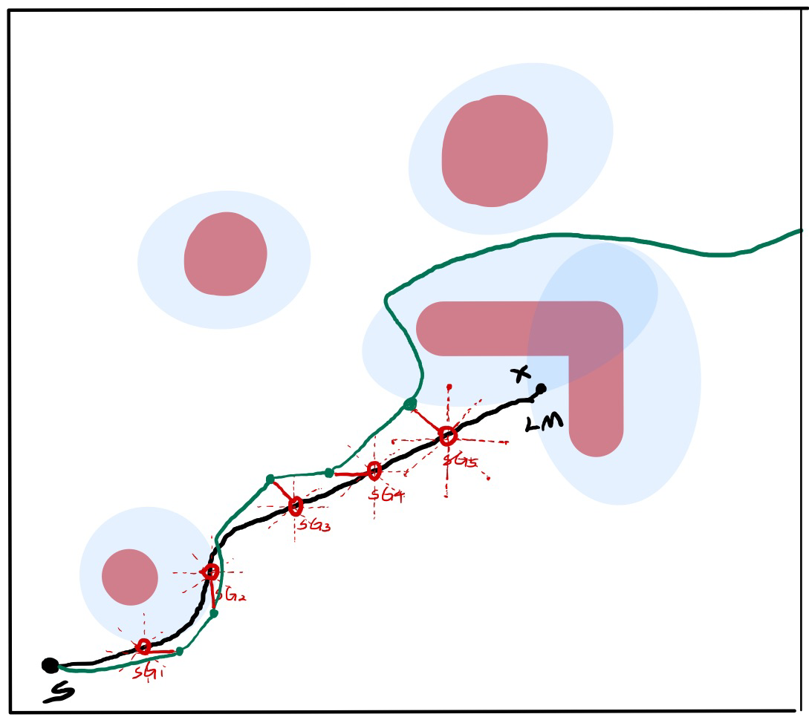
Conventional neighbourhood Example
Move up neighbourhood
Random eight directions neighbourhood
Subgoal list = [SG₁, SG₂, SG₃,SG₄]
All the subgoal lists in this neighbourhood have different sizes of upward offset.
Subgoal shifts randomly from eight directions
Notes:
this is the example of moving up neighborhood, for this neighborhood, it is a set of solutions which have different magnitudes or sizes of shift up, like these three neighbour represented in three different colors(green, red and purple).
random 8 neighbourhood is just Randomly choose some new subgoals from eight directions

Slide 26
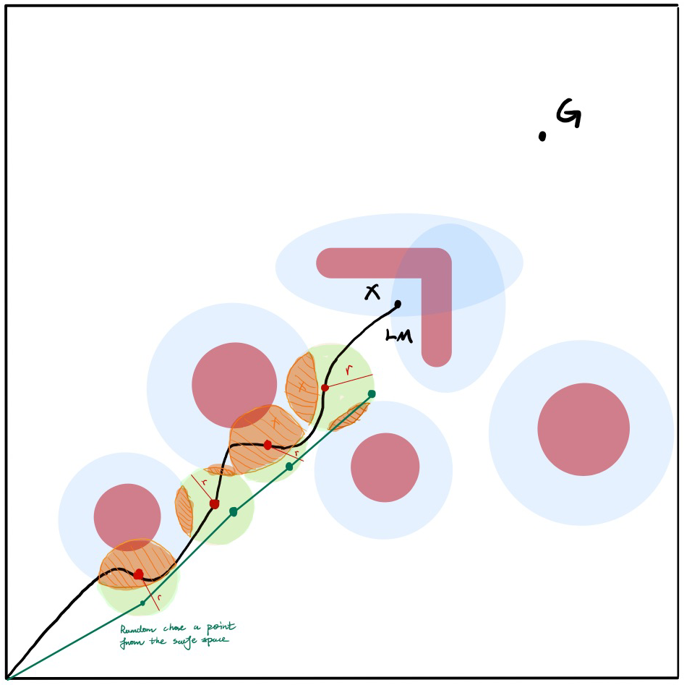
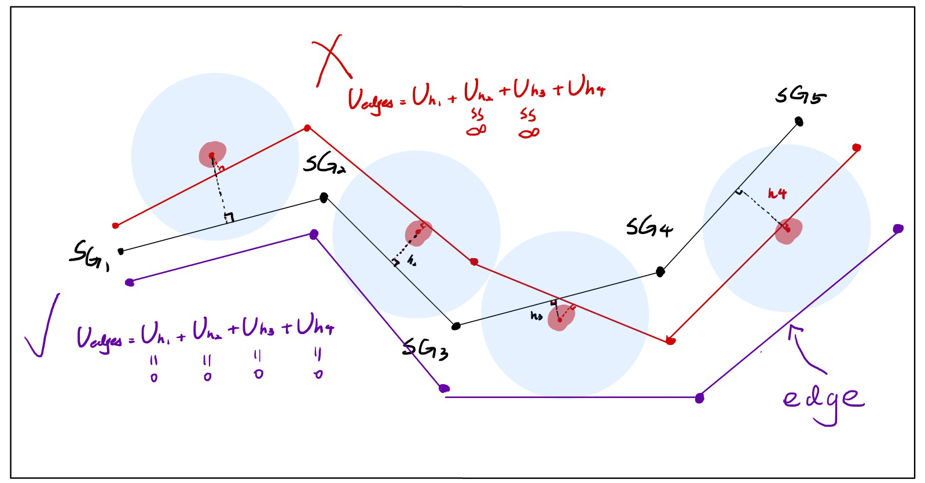
Local path optimization neighbourhood example
Avoiding obstacles neighbourhood
Edge optimization neighbourhood
Move the edge out of the obstacle area. Like the purple subgoals
All the subgoal lists in this neighbourhood are trying to avoid the obstacles. (subgoal location Domain is the green area)
Notes:
Edge optimization neighbourhood tends to select the neighbour that their edges are out of the obstacle coverage. so this purple neighbour is a valid and good one in this neighbourhood because None of the edges are in the obstacle area.
Avoiding obstacles neighbourhood is like randomly choose some subgoals that are not in the coverage of the obstacles, so like choosing some subgoals in the green safe area, rather than the orange area.

Slide 27
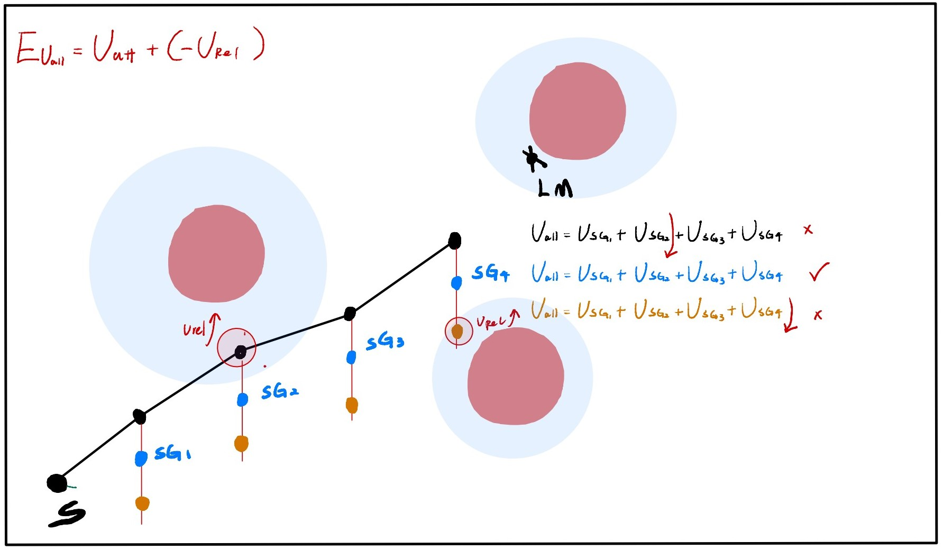
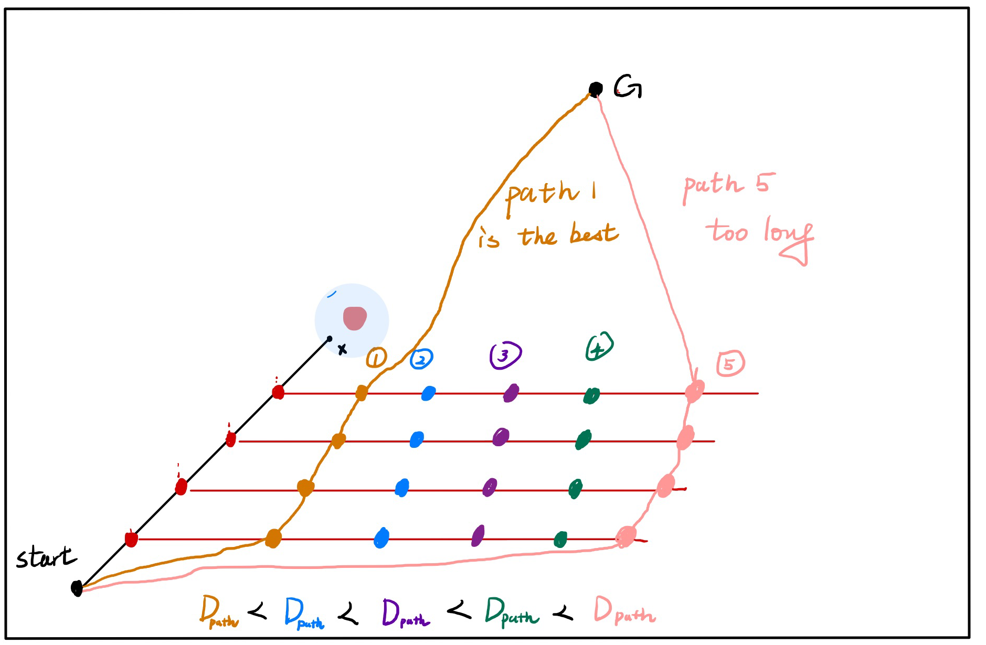
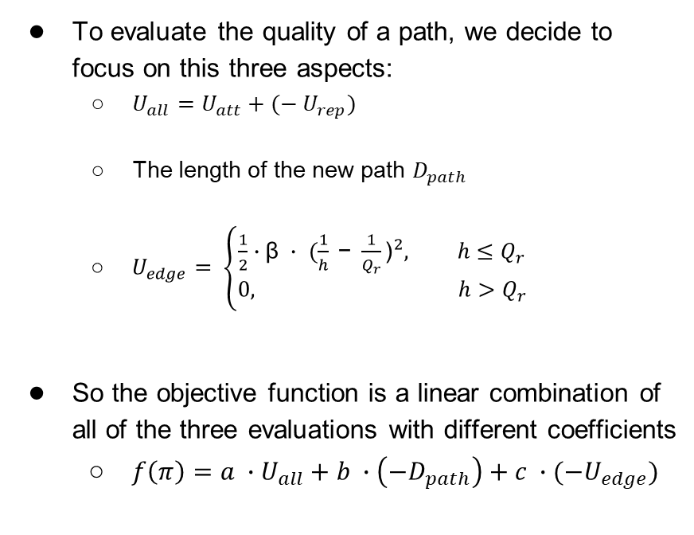
Evaluation
To evaluate the quality of a path, we decide to focus on this three aspects:
$U_{all}=U_{att}+{(− U}_{rep})$
The length of the new path $D_{path}$
$U_{edge}= \left\{\begin{aligned}\frac{1}{2}∙\text{β} ∙ {(\frac{1}{h} \text{− }\frac{1}{Q_{r}}\text{)}}^{2}, h≤Q_{r} \\ &0, h>Q_{r}\end{aligned}\right.$
So the objective function is a linear combination of all of the three evaluations with different coefficients
$f\left(π\right)=a ∙U_{all}+b ∙\left(−D_{path}\right)+c ∙(−U_{edge})$
U_{all}= U_{att} + (- U_{rel})
The length of the new path D_{path}
Notes:
To evaluate the quality of a path, we decide to focus on this three aspects
the first one is the total potential evaluation, it uses the attractive potential and the negative repulsive potential function to calculate it. This evaluation tends to move the subgoals to the place where has strong attractive potential. Look at the graph in the upper right corner, we would like to choose the blue sub-goals because all of the subgoals are outside the obstacle coverage
second one is the length of the new path generated by the subgoals, for this evaluation we just don’t want it to be too long like the pink one in the lower-right graph.
also a special one, U edge measures the influence of obstacles on the edge
So the objective function is a linear combination of all of the three evaluations with different coefficients

Slide 28
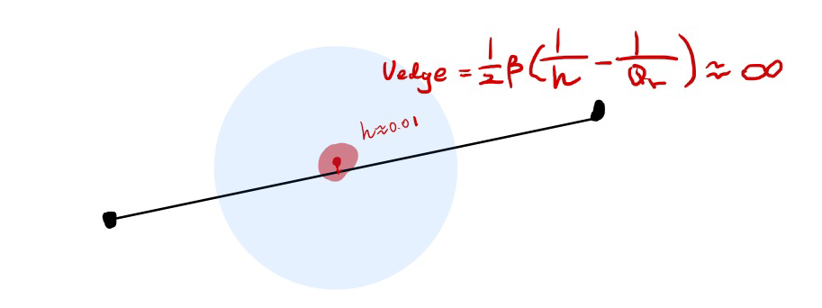
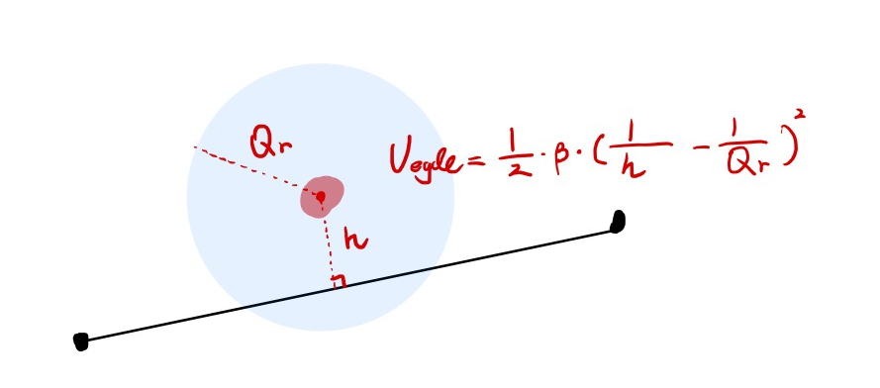
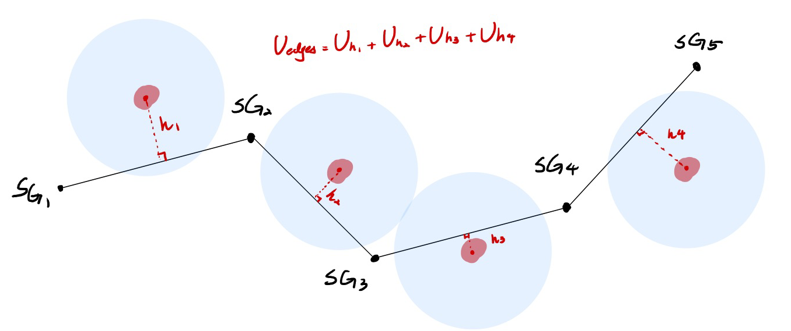
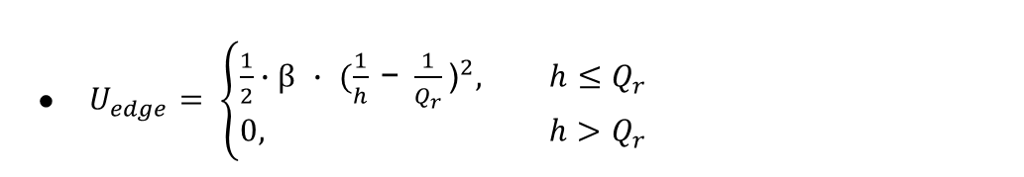
Evaluation (cont.)
$U_{edge}= \left\{\begin{aligned}\frac{1}{2}∙\text{β} ∙ {(\frac{1}{h} \text{− }\frac{1}{Q_{r}}\text{)}}^{2}, h≤Q_{r} \\ &0, h>Q_{r}\end{aligned}\right.$
Notes:
for the special edge potential evaluation, we just evaluate the influence of obstacles on the edge between the two sub-goals, we use this perpendicular to calculate the value of U_edge function We want the value to be as low as possible. if the perpendicular is too close to the center, the value will be infinity.

Slide 29
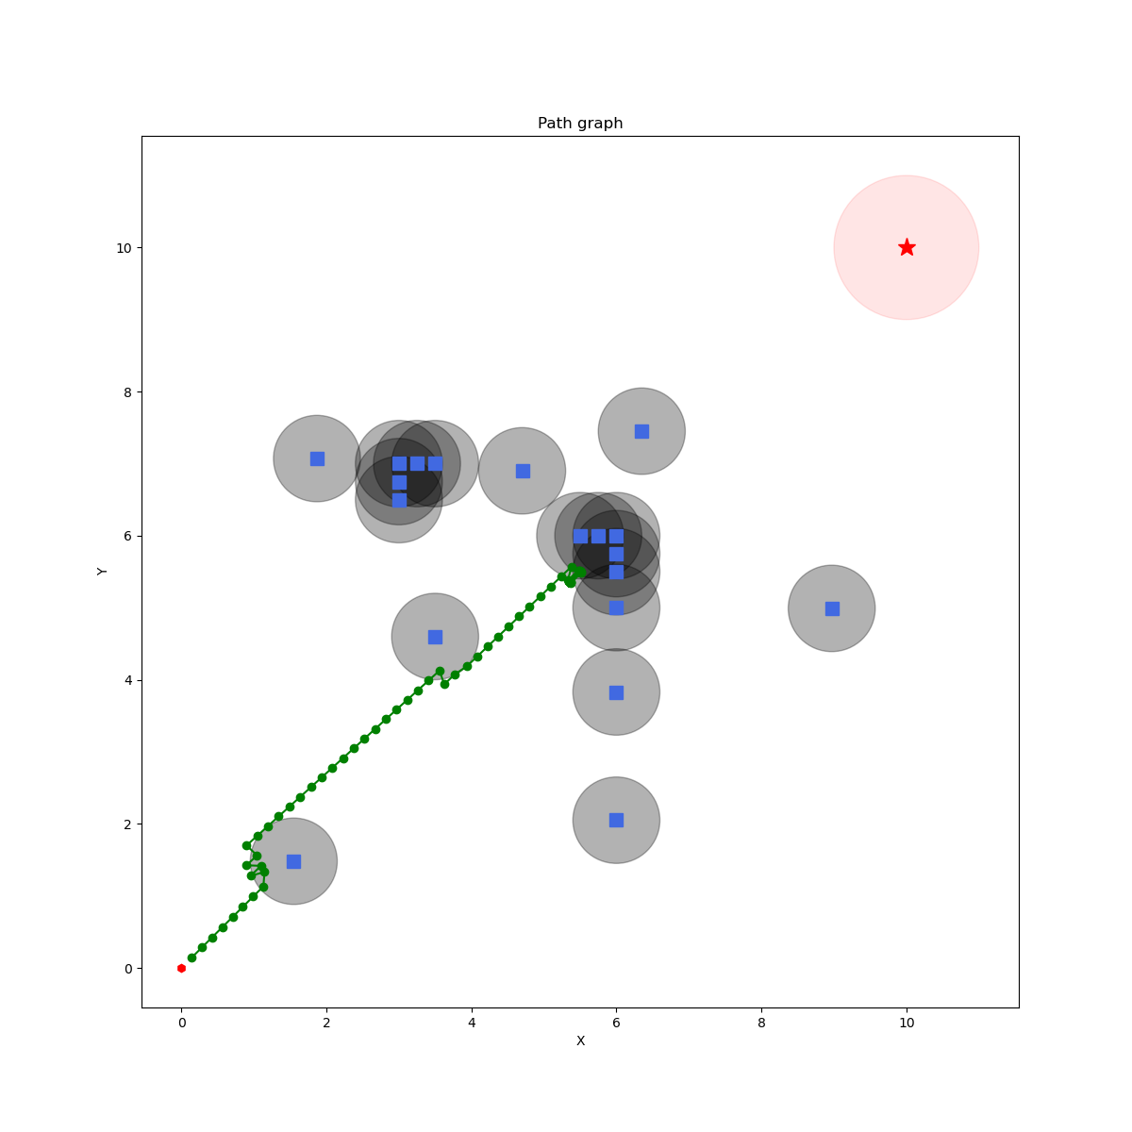
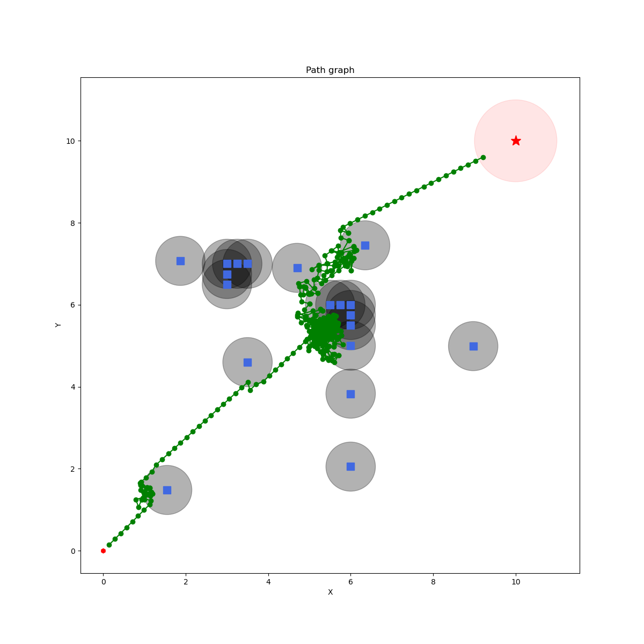
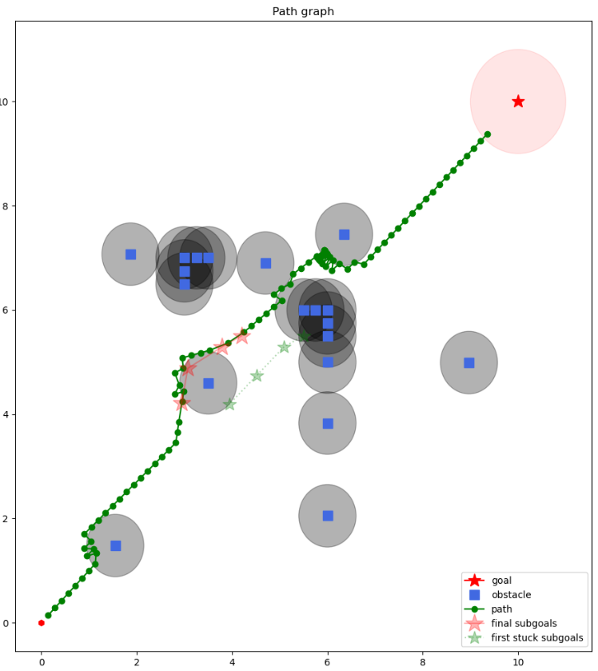
Conclusion
Our approach can achieve the local minima avoidance and finally reach the goal.
And the path it generated is shorter than the path generated by using SA. It is also more efficient.
Theoretically, the path can be a suboptimal solution if the parameter set and coefficients are selected appropriately.
Original APF
APF-SA
APF-VNS
Final subgoals
Initial subgoals
Notes:
our experiment result shows that Our approach can achieve the local minima avoidance, and the path is shorter than the path generated by using SA. Theoretically, the path can be a suboptimal solution if the parameter set and coefficients are selected properly.
we compare our new approach with the original APF and the APF with SA. The purpose of using the Original APF is proving that there is indeed a local minimum exists. the APF with SA is another traditional approach which can achieve the goal but using a very long, and less efficient path. Our new approach can do better, the path is very short and very smooth.

Slide 30
Derived research
We evaluate different combinations of neighborhoods, and the score of a combination C is given by:
score(C) = the number of subgoal lists that the agent has used (the number of subgoals used from initial one to final one)
We evaluate our approach on a pre-set complex map where the agent will definitely stuck at local minima.
We evaluate the following VNS neighborhoods configurations:
C_{rand-only} : [random eight, random]
C_{4-dir} : [up, right, left, down]
C_{4-dir-obsFree} : [up, right, left, down, obs-free]
C_{local-opz} : [all the local path optimization neighbourhoods]
C_{all} : [four direction + local path optimization + random]
Notes:
We also evaluate the result of different combinations of neighborhoods, and we evaluate it by using this score function, which is the number of sub-goals that have been used and failed to escape from the local minima.
so We evaluate the following 5 VNS neighborhoods configurations:
Rand-only combination
4 directions combination
Obstacle-free combination
Local path optimization combination
All neighbourhood combination

Slide 31
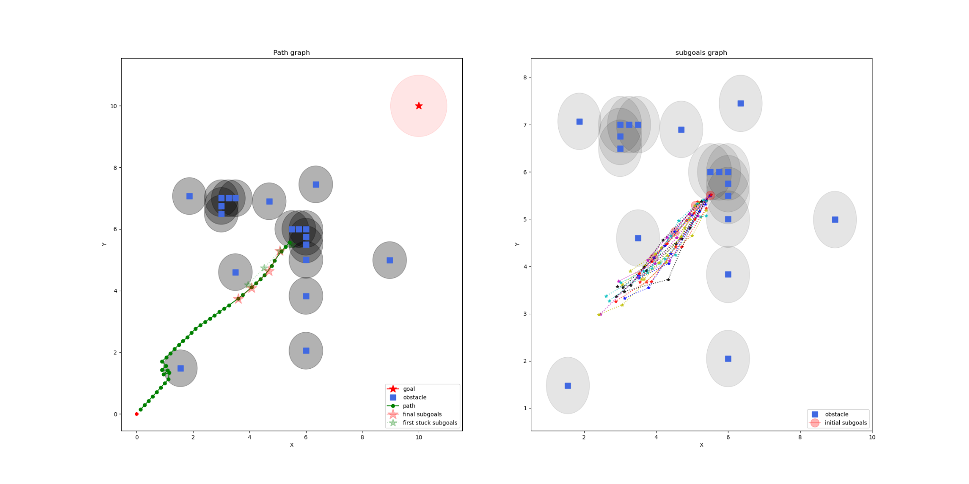
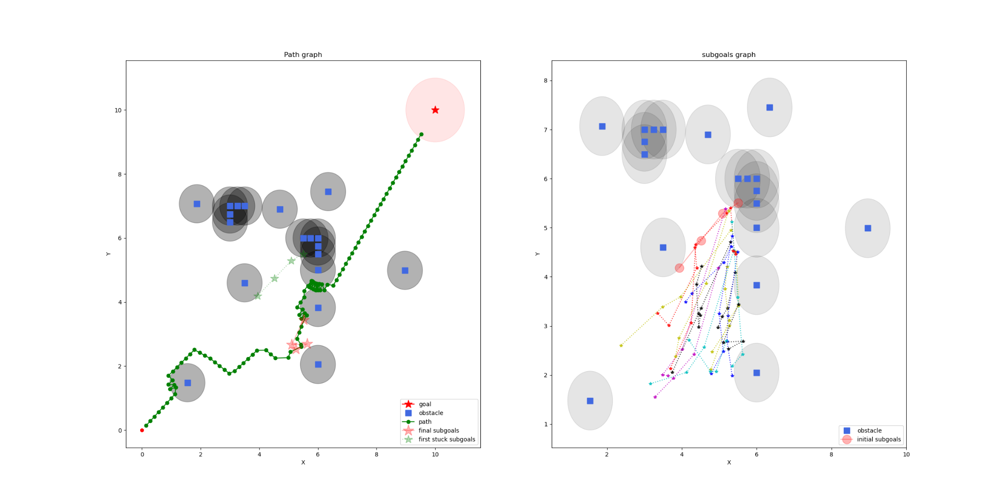
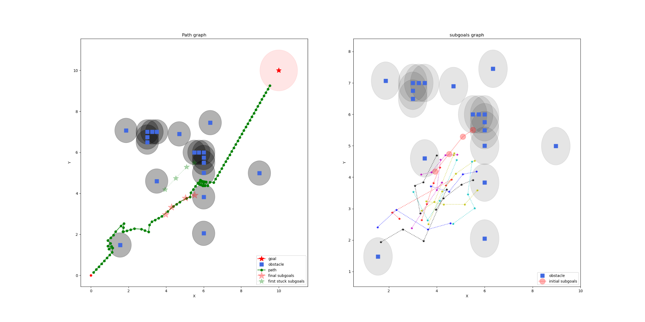
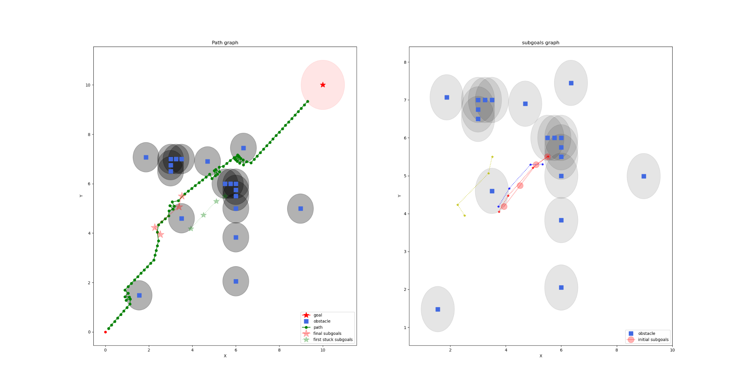
Visualization – subgoals
C_{rand-only} : [random eight, random]
very bad
Can not reach the goal
C_{4-dir-obsFree}
all the subgoals keep away form the obstacles
Can reach the goal
score
C_{4-dir} : [up, right, left, down]
achieve the goal
a lot of Parallel trajectories
C_{all}
use less than 5 subgoal lists to reach the goal
Path is short
Notes:
the upper left diagram is the result of using ran-only neighbourhood combination, there are a lot of subgoals that the agent has tried and failed, keep in mind that, The more sub-goals it uses, the less efficient it is
the lower left diagram is the result of using 4 direction neighbourhood combination, As you can see in the picture, this combination only allows the subgoals moving in four directions, so there are a lot of Parallel trajectories in this graph.
the upper right diagram is the result of using obstacles free neighbourhood combination, you can easily see that almost all the subgoals are trying to move away from the obstacles
the lower right diagram is the result of using all neighbourhoods combination, it works well because it has the powerful local path optimization neighbourhood, and it uses less than 5 subgoal lists to reach the goal

Slide 32
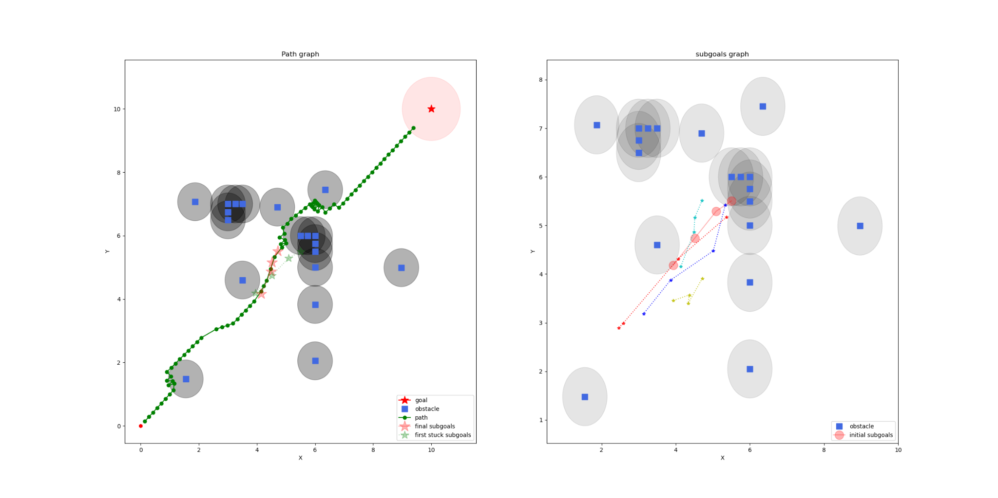
Visualization – path
C_{rand-only} : [random eight, random]
C_{4-dir-obsFree}
Prefer the path with fewer obstacles
C_{4-dir} : [up, right, left, down]
C_{all}
Relatively short path
Notes:
And this is the path visualization of different combinations, you can see that the ran-only neighbourhood cannot reach the goal, another observation is that the path of C_{all} is relatively shorter than other two combination’s paths

Slide 33
Conclusion 2
 | Escape from the LM? | Score | Path length
C_{rand-only} | Sometime failure | 50+ | None
C_{4-dir} | Yes | 14.6324 | 27.143
C_{4-dir-obsFree} | Yes | 23.4556 | 19.562
C_{local-opz} | Yes | 3.73 | 16.145
C_{all} | Yes | 3.41 | 15.084
C_{local-opz} and C_{all} are the best because of the local path optimization neighbourhood
C_{4-dir} can achieve the goal but using more sub-goals than C_{local-opz} or C_{all}
Notes:
this is the conclusion of different combinations result. We conclude that C_{local-opz} and C_{all} are the best because of the local path optimization neighbourhood and the length of the path is very short

Slide 34
Section 4: Extension and future work
Limitation on APF-VNS
Improvement of proposed approach and future work
Introducing Deep deterministic policy gradient (DDPG)
Combining DDPG with proposed method -> DDPG-APF-VNS

Slide 35
Limitation on APF + VNS
VNS-APF is slow and requires more CPU power and memory.
It is a trade-off between optimality and planning time
Traverses all the neighbourhoods and trying the new sub-goals are time-consuming
The length of the path generated by the APF-VNS varies within a range
VNS is essentially a stochastic local search approach
Lack of learning ability
Cannot optimize itself from all the paths that have already been generated

Slide 36
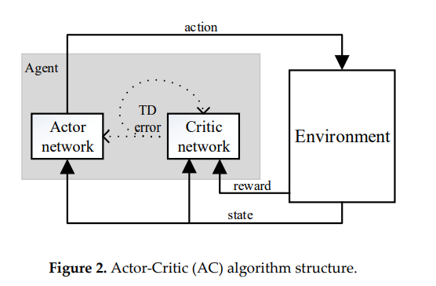
Actor Critic Algorithm
DDPG is based on AC algorithm
AC framework = a policy network + an evaluation network
select actions evaluates the merits and actions
giving a better gradient estimate
Reference: Timothy P. Lillicrap∗ , Jonathan J. Hunt∗ , Alexander Pritzel, Nicolas Heess, Tom Erez, Yuval Tassa, David Silver & Daan Wierstra, CONTINUOUS CONTROL WITH DEEP REINFORCEMENT LEARNING, Google Deepmind London, UK

Slide 37
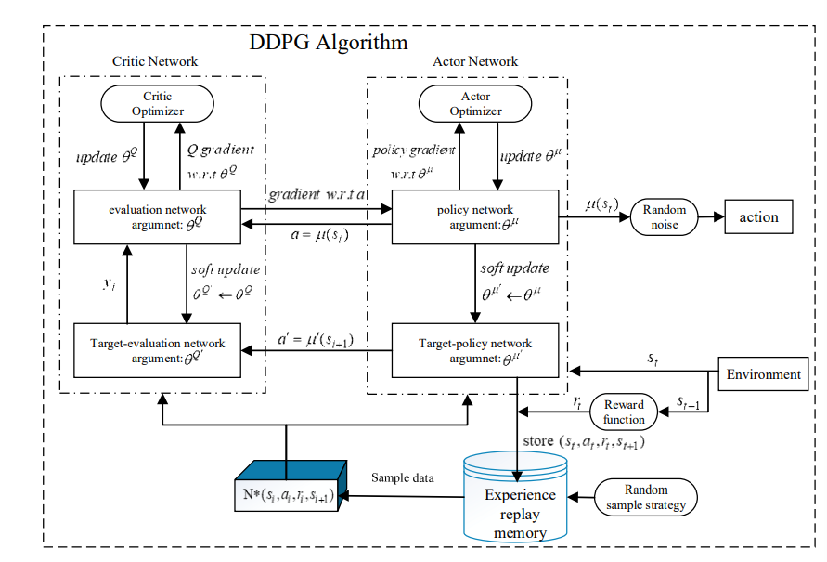
Deep Deterministic Policy Gradient (DDPG)
DQN + AC algorithm
DQN memory replay memory

Slide 38
Why DDPG-APF?
DDPG training time is longer, the convergence speed is slower, and the algorithm is easy to fall into the problem of local iteration.
DDPG has no prior knowledge of the environment
The convergence speed of the algorithm is slow in complex environments.
Thus, combining APF with DDPG algorithm, in order to improve the learning efficiency in the initial stage and speed up the convergence of the algorithm.

Slide 39
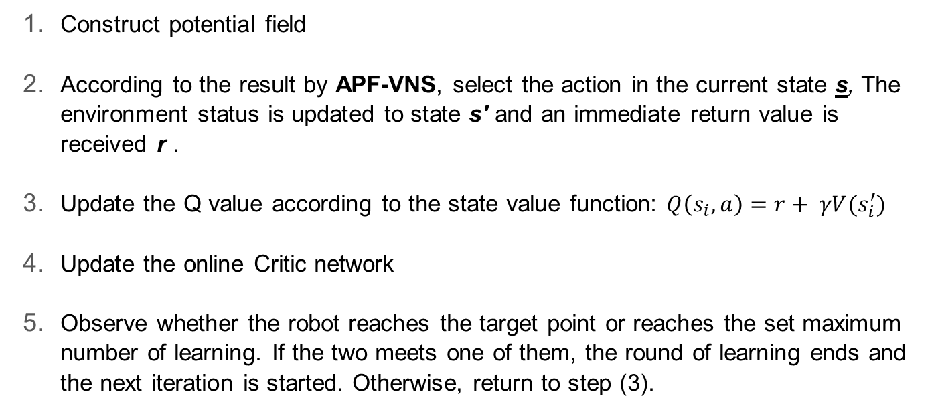
DDPG-APF-VNS
Construct potential field
According to the result by APF-VNS, select the action in the current state s, The environment status is updated to state s′ and an immediate return value is received r .
Update the Q value according to the state value function: $Q\left(s_{i},a\right)=r+ γV(s_{i}^{′})$
Update the online Critic network
Observe whether the robot reaches the target point or reaches the set maximum number of learning. If the two meets one of them, the round of learning ends and the next iteration is started. Otherwise, return to step (3).

Slide 40
Thank you
Notes:
Bound?
The objective function will decide the bound of the path because the it contains the length of the path evaluation
Offline?
Yes, in the normal case, it will choose the Move in the direction of the fastest gradient of descent, and then if it is stuck at the local minimum, it will extract 5 or more subgoals from the existed path that causes the local minimum to occur, and the algorithm will using the VNS to manipulate the subgoals, like change the position according to some rules.
Optimal?
The objective function contains the total potential evaluation which will move the subgoals to the place where has strong potential and less obstacles, and the length of path evaluation will try to make the length as short as possible, so if the coefficients abc are selected properly, it is possible to find an optimal path.
Shuffling?
Our shuffling function is select one subgoal in the sub-goal list, and then randomly choose a direction in all direction
Neighbourhood?
Take a subgoal list, and create A set of subgoal lists according to some rules such as move up neighbourhood, each subgoal shift up to a different magnitudes or sizes of length

